Slide 1
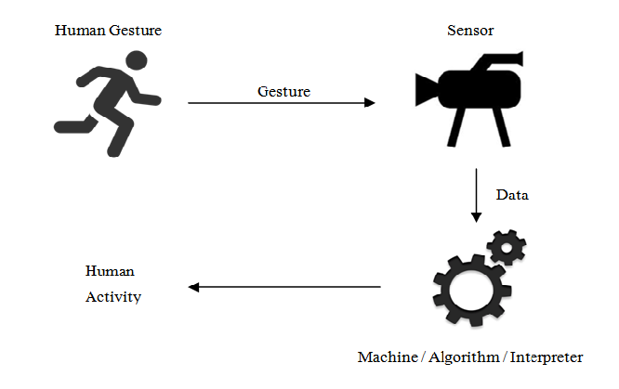
Human activity recognition using machine learning

Slide 2
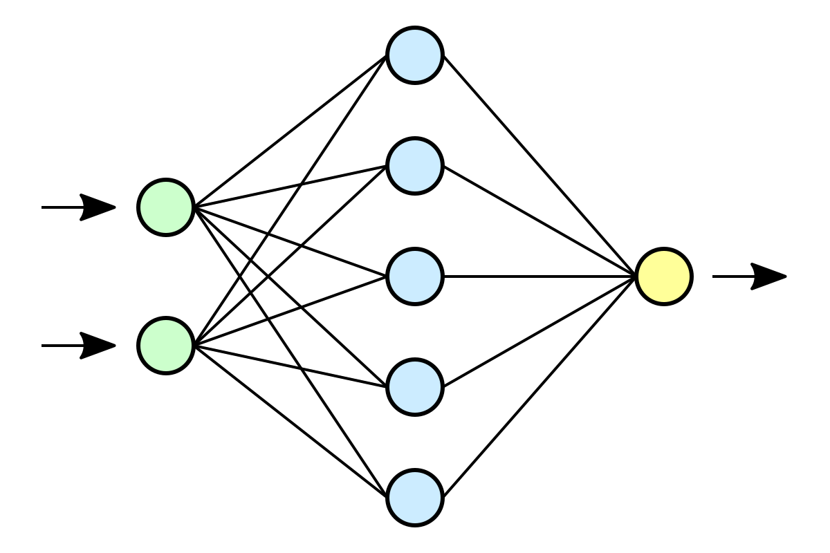
Approach
Neural networks due to their ability to generalize the knowledge that an individual provides and learning about particularities, are the perfect tools to determine a person's physical activity.

Slide 3
Neural networks
The network consists of simple processing elements that are interconnected via weights.
The network is first trained using an appropriate learning algorithm for the estimation of interconnecting weights.
Once the network is trained, unknown test signals can be classified.

Slide 4
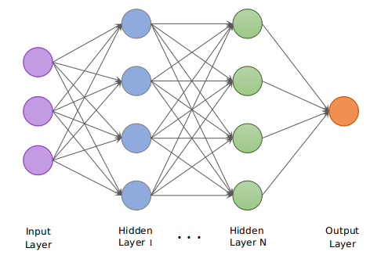
Convolution neural networks
A Convolutional Neural Network (ConvNet/CNN) is an algorithm which can take in an input , assign importance (learnable weights and biases) to various aspects/objects in the input and be able to differentiate one from the other.
A Convolutional Neural Network or CNN is basically a deep neural network which consists of hidden layers having convolution and pooling functions in addition to the activation function.

Slide 5
The architecture of a ConvNet is analogous to that of the connectivity pattern of Neurons in the Human Brain and was inspired by the organization of the Visual Cortex.
The role of the ConvNet is to reduce the input into a form which is easier to process, without losing features which are critical for getting a good prediction.
CNN models will pass each input through a series of convolution layers with filters (Kernels), Pooling, fully connected layers (FC) and apply activation function to classify an object with probabilistic values between 0 and 1.

Slide 6

Framework
Human activity repository
Loading and pre-processing of data
2D CNN model
Final result

Slide 7
Steps in recognition
Loading and processing the Dataset
Balancing the data of dataset
Standardization of data
Frame Preparation
2D CNN Model
Confusion Matrix

Slide 8
Steps in data pre-processing
Error checking
Data frame creation
Data balancing
Considering data line by line. Number of the line throwing the error will be displayed.
Creating data frame with processed data and proper column names.
Taking equal samples of each activity to avoid overfitting.
Reshaping
Frame preparation
Data Standardisation
Reshaping the data to make it acceptable by CNN
Dividing data into frames
Bringing values in same range

Slide 9
Accelerometer sensor dataset
The project presents an approach to recognize activities of daily living using a publicly available accelerometer sensor dataset .
The features of the signal are selected based on the time and frequency domain.

Slide 10
Used dataset
The dataset contains data collected through controlled, laboratory conditions. The total number of examples is 1,098,207.
The dataset contains six different labels (Downstairs, Jogging, Sitting, Standing, Upstairs, Walking).
Link: http://www.cis.fordham.edu/wisdm/dataset.php

Slide 11
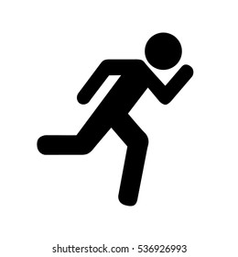
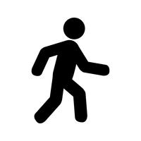
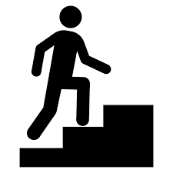
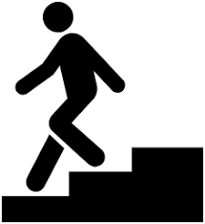
activities performed in dataset
1. Sitting
2. Standing
3. Jogging
4. Walking
5. Upstairs
6. Downstairs

Slide 12
Objectives
Obtaining the data from a dataset.
Preprocessing and feature extraction.
Resizing and standardizing of data.
2D- CNN classifier based activity recognition.
Better recognition using subsequent levels.

Slide 13
Libraries used
pandas is used to read the dataset.
numpy is used to perform basic array operations.
pyplot from matplotlib is used to visualize the results.
train_test_split from sklearn is used split the data into training and testing dataset.
LabelEncoder from sklear is used to encode target labels with value between 0 and
number of classes-1.
StandardScaler from sklearn is used to bring all the data in the
same scale.
Tensorflow –keras is being used to build the CNN.
All necessary layers are imported to build the CNN.

Slide 14
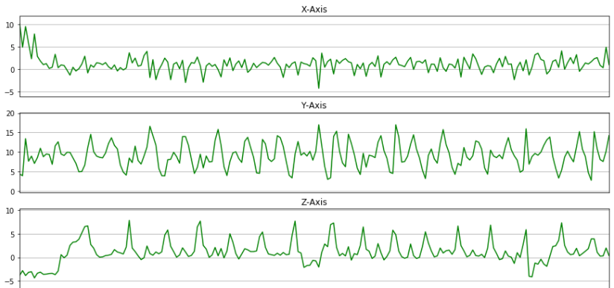
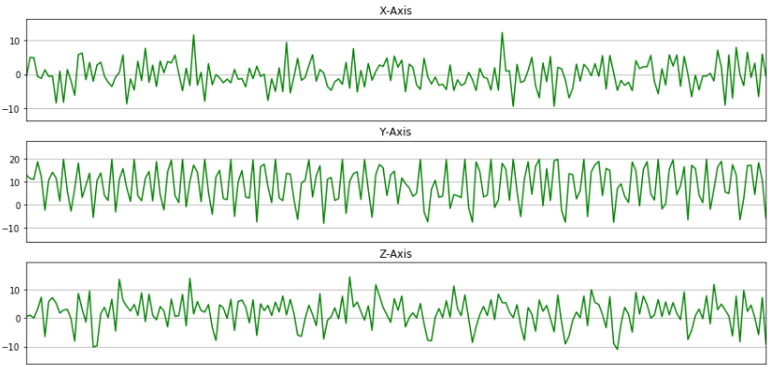
Plotting x,y,z of each activity
Upstairs
Jogging

Slide 15
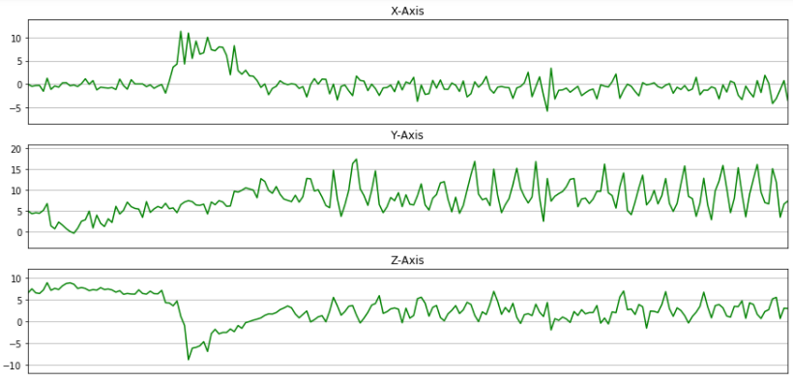
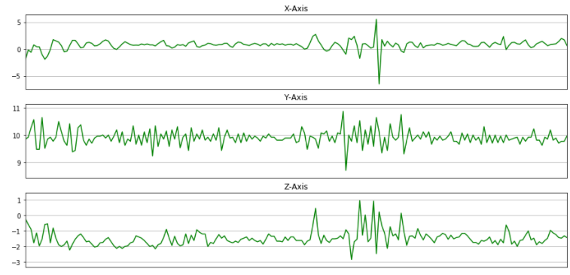
Downstairs
Standing

Slide 16
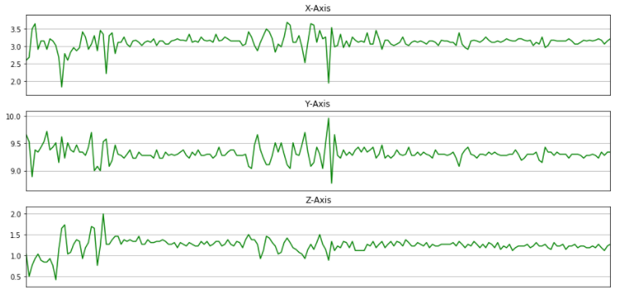
Sitting
Walking

Slide 17
Activation function
The activation function used is Softmax.
The Softmax activation function calculates the relative probabilities
The elements of the output vector are in range (0, 1) and sum to 1.
Softmax is often used as the activation for the last layer of a classification network because the result could be interpreted as a probability distribution.

Slide 18
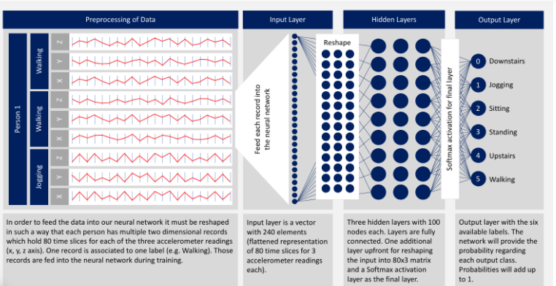

Slide 19
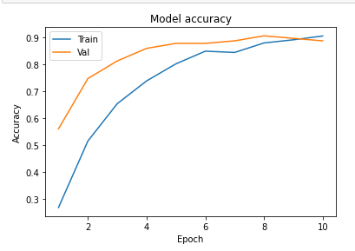
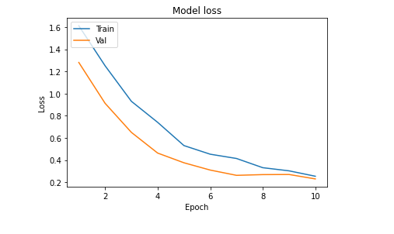
Plotting model accuracy and model loss
In model accuracy ,the training accuracy and validation accuracy are plotted .
In model loss ,the training loss and validation loss are plotted.

Slide 20
Expected applications
Medical diagnostic-with the help of sensory devices, an HAR system can keep track of the health condition of a patient and notify the health personnel in case of an urgent need.
Healthcare systems - it can help caregivers in monitoring the health of elderly people, particularly the ones who are living independently in their own homes and identify any abnormalities regarding their daily lives.
Human-computer interaction, and robotics for human behavior characterization using multiple activity recognition system.
Fitness tracking.

Slide 21
Project group g-15
Gurpreet Singh brar
Harneet Kaur
D3CSA1
1805178
D3CSA1
1805182

